Slide 1
CS2100 Tutorial 11
Cache
While waiting, do fill the end-of-sem feedback
https://blue.nus.edu.sg
Slides by Theodore, adapted from Prof. Aaron’s slides

Slide 2
Errata / Additional info for pipelining
! For exams ! (Checked with Prof. Anandha on Wed)
For non-ideal pipeline with branching:
Resolution stages: MEM (default), ID (early)
Branch prediction: no prediction, predict not taken (default), predict taken
Reordering of instructions: no reordering unless otherwise mentioned
You have the option to ask in exam if you think an assumption is not stated clearly

Slide 3
Announcement
Consult
Past Year Paper
Attendance marks

Slide 4
Recap
Types of cahces
direct mapped cache
n-way associative
fully associative

Slide 5
Q1a
Info from question:
Machine is byte-addressable
Word size is 16 bits (2 bytes)
Address space spanned by 32 bits
Cache:
16 blocks
2 word in a block

Slide 6
Q1a
Valid words:
0x00
0x02
0x04
…
Invalid words (but valid address):
0x01
0x03
0x05
…
Info from question:
Machine is byte-addressable
Word size is 16 bits (2 bytes)
Address space spanned by 32 bits
Cache:
16 blocks
2 words in a block
16 blocks: index of size 4

Slide 7
Q1a
Info from question:
Machine is byte-addressable
Word size is 2 bytes → last bit needs to be 0 for a valid word
Address space spanned by 32 bits
Cache:
16 blocks → index size 4
2 words in a block
Example address: 0b0000 0000 0000 0000 0000 0000 0000 0000

Slide 8
Q1a
Info from question:
Machine is byte-addressable
Word size is 2 bytes → last bit needs to be 0 for a valid word
Address space spanned by 32 bits
Cache:
16 blocks → index size 4
2 words in a block
Example address: 0b0000 0000 0000 0000 0000 0000 0000 0000

Slide 9
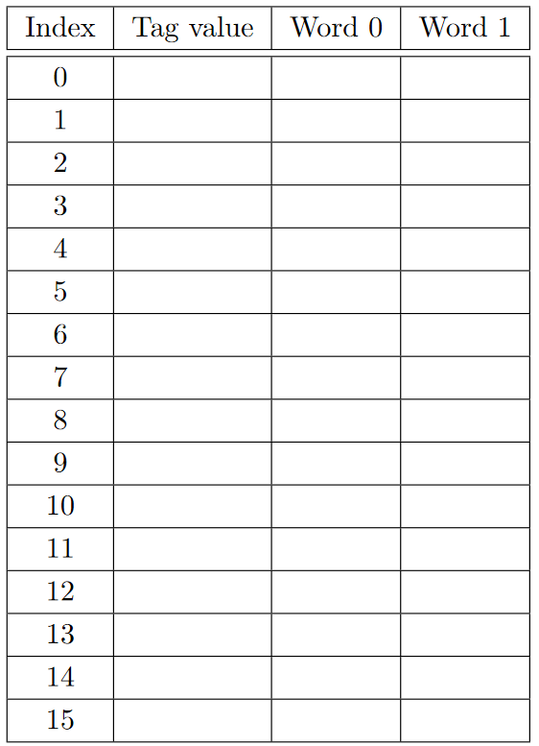
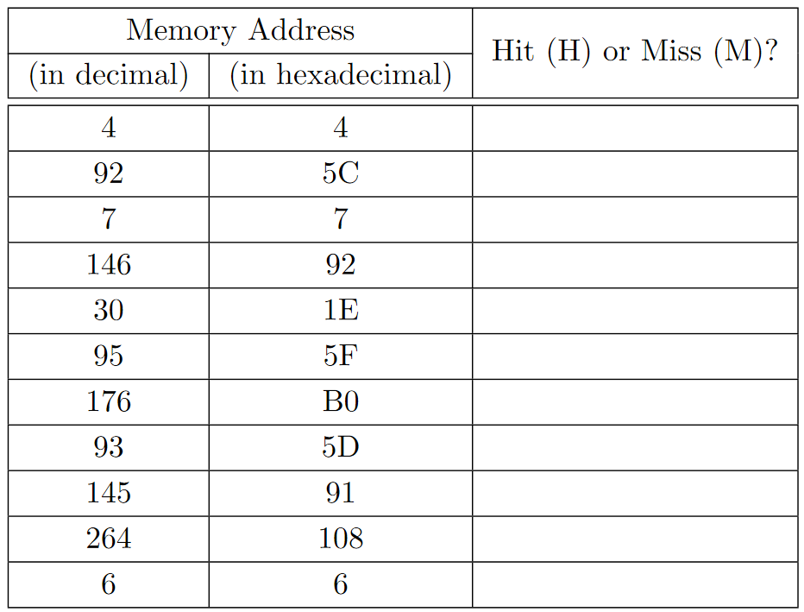
Q1a

Slide 10
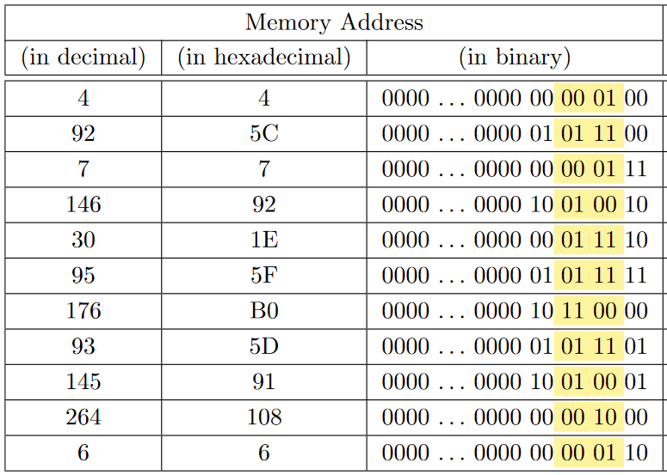
Q1a

Slide 11
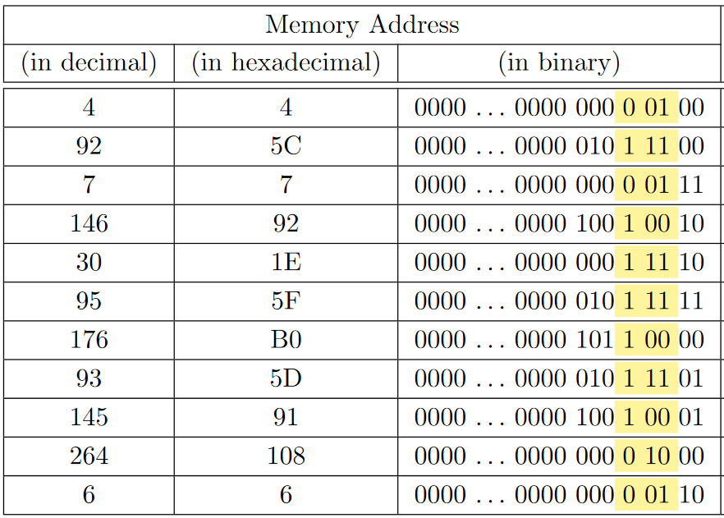
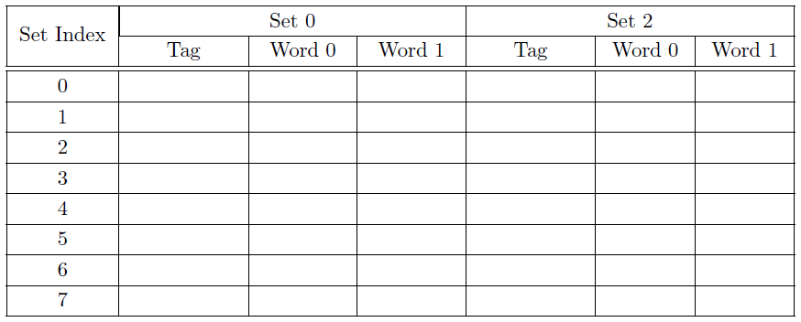
Q1b

Slide 12
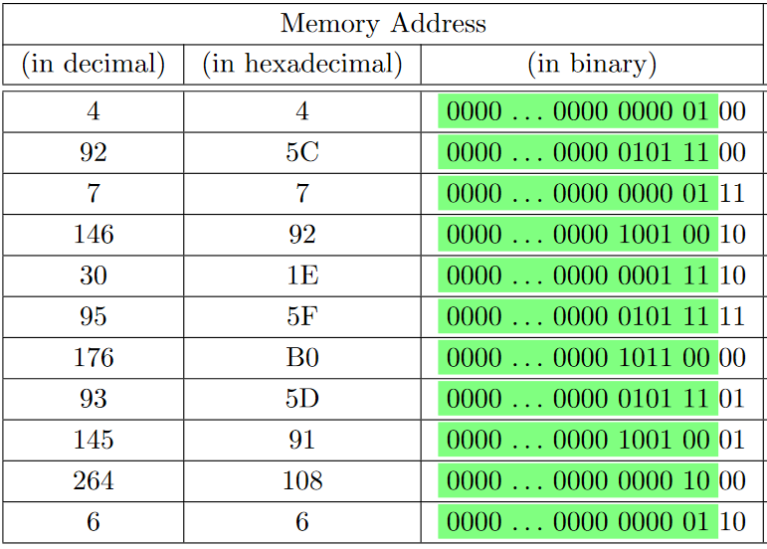
Q1c

Slide 13
Q2
MIPS
Addresses are 32 btis
Words are 4 bytes each
→ consecutive words differ by 4 in their address
→ all words' addresses end with 00
4 blocks in cache, 2 words each
→ 1 bit to distinguish the different words
→ 2 bits for index
0b0000 0000 0000 0000 0000 0000 0000 0000
start:
la $s0, A #PC=0x100
la $s1, B #PC=0x104
li $t0, 1 #PC=0x108
loop:
slt $t1, $t0, 1000 #PC=0x10c
beq $t1, $zero, endl #PC=0x110
sll $t2, $t0, 2 #PC=0x114
add $t3, $s0, $t2 #PC=0x118
lw $a0, 0($t3) #PC=0x11c
add $t4, $s1, $t2 #PC=0x120
lw $a1, 0($t4) #PC=0x124
add $v0, $a0, $a1 #PC=0x128
sw $v0, -4($t3) #PC=0x12c
addi $t0, $t0, 1 #PC=0x130
j loop #PC=0x134
endl:
Index | Tag | Word 0 | Word 1
0
1
2
3

Slide 14
Q2
$t0 starts at 1; $t2 = $t0 x 4
$t3 = $s0 + $t2
→ first lw is on memory 0x1000 + 4 = 0x1004
$t4 = $s1 + $t2
→ second lw is on memory 0x4010 + 4 = 0x4014
And first sw is on $t3 – 4
→ 0x1004 – 4 = 0x1000
At the end of iteration, $t0++.
start:
la $s0, A #PC=0x100
la $s1, B #PC=0x104
li $t0, 1 #PC=0x108
loop:
slt $t1, $t0, 1000 #PC=0x10c
beq $t1, $zero, endl #PC=0x110
sll $t2, $t0, 2 #PC=0x114
add $t3, $s0, $t2 #PC=0x118
lw $a0, 0($t3) #PC=0x11c
add $t4, $s1, $t2 #PC=0x120
lw $a1, 0($t4) #PC=0x124
add $v0, $a0, $a1 #PC=0x128
sw $v0, -4($t3) #PC=0x12c
addi $t0, $t0, 1 #PC=0x130
j loop #PC=0x134
endl:
Index | Tag | Word 0 | Word 1
0
1
2
3

Slide 15
Q2
$t0 starts at 1; $t2 = $t0 x 4
$t3 = $s0 + $t2
→ first lw is on memory 0x1000 + 4 = 0x1004
$t4 = $s1 + $t2
→ second lw is on memory 0x4010 + 4 = 0x4014
And first sw is on $t3 – 4
→ 0x1004 – 4 = 0x1000
At the end of iteration, $t0++.
start:
la $s0, A #PC=0x100
la $s1, B #PC=0x104
li $t0, 1 #PC=0x108
loop:
slt $t1, $t0, 1000 #PC=0x10c
beq $t1, $zero, endl #PC=0x110
sll $t2, $t0, 2 #PC=0x114
add $t3, $s0, $t2 #PC=0x118
lw $a0, 0($t3) #PC=0x11c
add $t4, $s1, $t2 #PC=0x120
lw $a1, 0($t4) #PC=0x124
add $v0, $a0, $a1 #PC=0x128
sw $v0, -4($t3) #PC=0x12c
addi $t0, $t0, 1 #PC=0x130
j loop #PC=0x134
endl:
Index | Tag | Word 0 | Word 1
0 | 0x0…0080 | M[0x1000] | M[0x1004]
1
2 | 0x0…0200 | M[0x4010] | M[0x4014]
3

Slide 16









Q2
$t0 starts at 1; $t2 = $t0 x 4
$t3 = $s0 + $t2
→ first lw is on memory 0x1000 + 4 = 0x1004
$t4 = $s1 + $t2
→ second lw is on memory 0x4010 + 4 = 0x4014
And first sw is on $t3 – 4
→ 0x1004 – 4 = 0x1000
At the end of iteration, $t0++.
start:
la $s0, A #PC=0x100
la $s1, B #PC=0x104
li $t0, 1 #PC=0x108
loop:
slt $t1, $t0, 1000 #PC=0x10c
beq $t1, $zero, endl #PC=0x110
sll $t2, $t0, 2 #PC=0x114
add $t3, $s0, $t2 #PC=0x118
lw $a0, 0($t3) #PC=0x11c
add $t4, $s1, $t2 #PC=0x120
lw $a1, 0($t4) #PC=0x124
add $v0, $a0, $a1 #PC=0x128
sw $v0, -4($t3) #PC=0x12c
addi $t0, $t0, 1 #PC=0x130
j loop #PC=0x134
endl:
Index | Tag | Word 0 | Word 1
0 | 0x0…0080 | M[0x1000] | M[0x1004]
1
2 | 0x0…0200 | M[0x4010] | M[0x4014]
3

Slide 17
Q2
$t0 starts at 1; $t2 = $t0 x 4
$t3 = $s0 + $t2
→ first lw is on memory 0x1000 + 4 = 0x1004
$t4 = $s1 + $t2
→ second lw is on memory 0x4010 + 4 = 0x4014
And first sw is on $t3 – 4
→ 0x1004 – 4 = 0x1000
At the end of iteration, $t0++.
start:
la $s0, A #PC=0x100
la $s1, B #PC=0x104
li $t0, 1 #PC=0x108
loop:
slt $t1, $t0, 1000 #PC=0x10c
beq $t1, $zero, endl #PC=0x110
sll $t2, $t0, 2 #PC=0x114
add $t3, $s0, $t2 #PC=0x118
lw $a0, 0($t3) #PC=0x11c
add $t4, $s1, $t2 #PC=0x120
lw $a1, 0($t4) #PC=0x124
add $v0, $a0, $a1 #PC=0x128
sw $v0, -4($t3) #PC=0x12c
addi $t0, $t0, 1 #PC=0x130
j loop #PC=0x134
endl:
Index | Tag | Word 0 | Word 1
0 | 0x0…0080 | M[1000] | M[1004]
1
2 | 0x0…0200 | M[4010] | M[4014]
3

Slide 18
Q2
(c) On the first iteration,
lw cold miss (0x1004); lw cold miss (0x4014); sw hit (0x1000)
start:
la $s0, A #PC=0x100
la $s1, B #PC=0x104
li $t0, 1 #PC=0x108
loop:
slt $t1, $t0, 1000 #PC=0x10c
beq $t1, $zero, endl #PC=0x110
sll $t2, $t0, 2 #PC=0x114
add $t3, $s0, $t2 #PC=0x118
lw $a0, 0($t3) #PC=0x11c
add $t4, $s1, $t2 #PC=0x120
lw $a1, 0($t4) #PC=0x124
add $v0, $a0, $a1 #PC=0x128
sw $v0, -4($t3) #PC=0x12c
addi $t0, $t0, 1 #PC=0x130
j loop #PC=0x134
endl:
Index | Tag | Word 0 | Word 1
0 | 0x0…0080 | M[0x1000] | M[0x1004]
1
2 | 0x0…0200 | M[0x4010] | M[0x4014]
3

Slide 19
Q2
(c) On the first iteration,
lw cold miss (0x1004); lw cold miss (0x4014); sw hit (0x1000)
On the second iteration,
lw cold miss (0x1008); lw cold miss (0x4018); sw hit (0x1004)
start:
la $s0, A #PC=0x100
la $s1, B #PC=0x104
li $t0, 1 #PC=0x108
loop:
slt $t1, $t0, 1000 #PC=0x10c
beq $t1, $zero, endl #PC=0x110
sll $t2, $t0, 2 #PC=0x114
add $t3, $s0, $t2 #PC=0x118
lw $a0, 0($t3) #PC=0x11c
add $t4, $s1, $t2 #PC=0x120
lw $a1, 0($t4) #PC=0x124
add $v0, $a0, $a1 #PC=0x128
sw $v0, -4($t3) #PC=0x12c
addi $t0, $t0, 1 #PC=0x130
j loop #PC=0x134
endl:
Index | Tag | Word 0 | Word 1
0 | 0x0…0080 | M[0x1000] | M[0x1004]
1 | 0x0…0080 | M[0x1008] | M[0x100C]
2 | 0x0…0200 | M[0x4010] | M[0x4014]
3 | 0x0…0200 | M[0x4018] | M[0x401C]

Slide 20
Q2
(c) On the first iteration,
lw cold miss (0x1004); lw cold miss (0x4014); sw hit (0x1000)
On the second iteration,
lw cold miss (0x1008); lw cold miss (0x4018); sw hit (0x1004)
At this point, cache is warmed up!
start:
la $s0, A #PC=0x100
la $s1, B #PC=0x104
li $t0, 1 #PC=0x108
loop:
slt $t1, $t0, 1000 #PC=0x10c
beq $t1, $zero, endl #PC=0x110
sll $t2, $t0, 2 #PC=0x114
add $t3, $s0, $t2 #PC=0x118
lw $a0, 0($t3) #PC=0x11c
add $t4, $s1, $t2 #PC=0x120
lw $a1, 0($t4) #PC=0x124
add $v0, $a0, $a1 #PC=0x128
sw $v0, -4($t3) #PC=0x12c
addi $t0, $t0, 1 #PC=0x130
j loop #PC=0x134
endl:
Index | Tag | Word 0 | Word 1
0 | 0x0…0080 | M[0x1000] | M[0x1004]
1 | 0x0…0080 | M[0x1008] | M[0x100C]
2 | 0x0…0200 | M[0x4010] | M[0x4014]
3 | 0x0…0200 | M[0x4018] | M[0x401C]

Slide 21
Q2
(c) First two iterations: 4 misses, 2 hits
At this point, cache is warmed up!
On the third iteration,
lw hit (0x100C), lw hit (0x401C), sw hit (0x1008)
start:
la $s0, A #PC=0x100
la $s1, B #PC=0x104
li $t0, 1 #PC=0x108
loop:
slt $t1, $t0, 1000 #PC=0x10c
beq $t1, $zero, endl #PC=0x110
sll $t2, $t0, 2 #PC=0x114
add $t3, $s0, $t2 #PC=0x118
lw $a0, 0($t3) #PC=0x11c
add $t4, $s1, $t2 #PC=0x120
lw $a1, 0($t4) #PC=0x124
add $v0, $a0, $a1 #PC=0x128
sw $v0, -4($t3) #PC=0x12c
addi $t0, $t0, 1 #PC=0x130
j loop #PC=0x134
endl:
Index | Tag | Word 0 | Word 1
0 | 0x0…0080 | M[0x1000] | M[0x1004]
1 | 0x0…0080 | M[0x1008] | M[0x100C]
2 | 0x0…0200 | M[0x4010] | M[0x4014]
3 | 0x0…0200 | M[0x4018] | M[0x401C]

Slide 22
Q2
(c) First two iterations: 4 misses, 2 hits
At this point, cache is warmed up!
On the third iteration,
lw hit (0x100C), lw hit (0x401C), sw hit (0x1008)
On the fourth iteration,
lw miss (0x1010), lw miss (0x4020), sw hit (0x100C)
start:
la $s0, A #PC=0x100
la $s1, B #PC=0x104
li $t0, 1 #PC=0x108
loop:
slt $t1, $t0, 1000 #PC=0x10c
beq $t1, $zero, endl #PC=0x110
sll $t2, $t0, 2 #PC=0x114
add $t3, $s0, $t2 #PC=0x118
lw $a0, 0($t3) #PC=0x11c
add $t4, $s1, $t2 #PC=0x120
lw $a1, 0($t4) #PC=0x124
add $v0, $a0, $a1 #PC=0x128
sw $v0, -4($t3) #PC=0x12c
addi $t0, $t0, 1 #PC=0x130
j loop #PC=0x134
endl:
Index | Tag | Word 0 | Word 1
0 | 0x0…0080 | M[0x1000] | M[0x1004]
1 | 0x0…0080 | M[0x1008] | M[0x100C]
2 | 0x0…0200 | M[0x4010] | M[0x4014]
3 | 0x0…0200 | M[0x4018] | M[0x401C]

Slide 23
Q2
(c) First two iterations: 4 misses, 2 hits
At this point, cache is warmed up!
On the third iteration,
lw hit (0x100C), lw hit (0x401C), sw hit (0x1008)
On the fourth iteration,
lw miss (0x1010), lw miss (0x4020), sw hit (0x100C)
start:
la $s0, A #PC=0x100
la $s1, B #PC=0x104
li $t0, 1 #PC=0x108
loop:
slt $t1, $t0, 1000 #PC=0x10c
beq $t1, $zero, endl #PC=0x110
sll $t2, $t0, 2 #PC=0x114
add $t3, $s0, $t2 #PC=0x118
lw $a0, 0($t3) #PC=0x11c
add $t4, $s1, $t2 #PC=0x120
lw $a1, 0($t4) #PC=0x124
add $v0, $a0, $a1 #PC=0x128
sw $v0, -4($t3) #PC=0x12c
addi $t0, $t0, 1 #PC=0x130
j loop #PC=0x134
endl:
Index | Tag | Word 0 | Word 1
0 | 0x0…0200 | M[0x4020] | M[0x4024]
1 | 0x0…0080 | M[0x1008] | M[0x100C]
2 | 0x0…0080 | M[0x1010] | M[0x1014]
3 | 0x0…0200 | M[0x4018] | M[0x401C]

Slide 24
Q2
(c) First two iterations: 4 misses, 2 hits
At this point, cache is warmed up!
On the third iteration,
lw hit (0x100C), lw hit (0x401C), sw hit (0x1008)
On the fourth iteration,
lw miss (0x1010), lw miss (0x4020), sw hit (0x100C)
On the fifth iteration,
lw hit (0x1014), lw hit (0x4024), sw hit (0x1010)
start:
la $s0, A #PC=0x100
la $s1, B #PC=0x104
li $t0, 1 #PC=0x108
loop:
slt $t1, $t0, 1000 #PC=0x10c
beq $t1, $zero, endl #PC=0x110
sll $t2, $t0, 2 #PC=0x114
add $t3, $s0, $t2 #PC=0x118
lw $a0, 0($t3) #PC=0x11c
add $t4, $s1, $t2 #PC=0x120
lw $a1, 0($t4) #PC=0x124
add $v0, $a0, $a1 #PC=0x128
sw $v0, -4($t3) #PC=0x12c
addi $t0, $t0, 1 #PC=0x130
j loop #PC=0x134
endl:
Index | Tag | Word 0 | Word 1
0 | 0x0…0200 | M[0x4020] | M[0x4024]
1 | 0x0…0080 | M[0x1008] | M[0x100C]
2 | 0x0…0080 | M[0x1010] | M[0x1014]
3 | 0x0…0200 | M[0x4018] | M[0x401C]

Slide 25
Q2
(c) First two iterations: 4 misses, 2 hits
At this point, cache is warmed up!
On the third iteration,
lw hit (0x100C), lw hit (401C), sw hit (0x1008)
On the fourth iteration,
lw miss (0x1010), lw miss (4020), sw hit (0x100C)
On the fifth iteration,
lw hit (0x1014), lw hit (0x4024), sw hit (0x1010)
On the sixth iteration,
lw miss (0x101C), lw miss (0x4028), sw hit (0x1014)
start:
la $s0, A #PC=0x100
la $s1, B #PC=0x104
li $t0, 1 #PC=0x108
loop:
slt $t1, $t0, 1000 #PC=0x10c
beq $t1, $zero, endl #PC=0x110
sll $t2, $t0, 2 #PC=0x114
add $t3, $s0, $t2 #PC=0x118
lw $a0, 0($t3) #PC=0x11c
add $t4, $s1, $t2 #PC=0x120
lw $a1, 0($t4) #PC=0x124
add $v0, $a0, $a1 #PC=0x128
sw $v0, -4($t3) #PC=0x12c
addi $t0, $t0, 1 #PC=0x130
j loop #PC=0x134
endl:

Slide 26
Q2
(c) First two iterations: 4 misses, 2 hits
At this point, cache is warmed up!
On the third iteration,
lw hit (0x100C), lw hit (0x401C), sw hit (0x1008)
On the fourth iteration,
lw miss (0x1010), lw miss (0x4020), sw hit (0x100C)
On the fifth iteration,
lw hit (0x1014), lw hit (0x4024), sw hit (0x1010)
On the sixth iteration,
lw miss (0x101C), lw miss (0x4028), sw hit (0x1014)
start:
la $s0, A #PC=0x100
la $s1, B #PC=0x104
li $t0, 1 #PC=0x108
loop:
slt $t1, $t0, 1000 #PC=0x10c
beq $t1, $zero, endl #PC=0x110
sll $t2, $t0, 2 #PC=0x114
add $t3, $s0, $t2 #PC=0x118
lw $a0, 0($t3) #PC=0x11c
add $t4, $s1, $t2 #PC=0x120
lw $a1, 0($t4) #PC=0x124
add $v0, $a0, $a1 #PC=0x128
sw $v0, -4($t3) #PC=0x12c
addi $t0, $t0, 1 #PC=0x130
j loop #PC=0x134
endl:
repeats!

Slide 27
Q2
(c) First two iterations: 4 misses, 2 hits
At this point, cache is warmed up!
On the third iteration,
lw hit (0x100C), lw hit (0x401C), sw hit (0x1008)
On the fourth iteration,
lw miss (0x1010), lw miss (0x4020), sw hit (0x100C)
For every two iterations between 3 to 998 (498 times), there will be 4 hits and 2 misses
Iteration 999: lw hit, lw hit, sw hit (3 hits, 0 misses)
Total hits: 2 + 4*498 + 3 = 1997
Total miss: 4 + 2*498 + 0 = 1000
Miss rate: 1000/2997 = 33.37%
start:
la $s0, A #PC=0x100
la $s1, B #PC=0x104
li $t0, 1 #PC=0x108
loop:
slt $t1, $t0, 1000 #PC=0x10c
beq $t1, $zero, endl #PC=0x110
sll $t2, $t0, 2 #PC=0x114
add $t3, $s0, $t2 #PC=0x118
lw $a0, 0($t3) #PC=0x11c
add $t4, $s1, $t2 #PC=0x120
lw $a1, 0($t4) #PC=0x124
add $v0, $a0, $a1 #PC=0x128
sw $v0, -4($t3) #PC=0x12c
addi $t0, $t0, 1 #PC=0x130
j loop #PC=0x134
endl:
repeats!

Slide 28
Q2
(b) We can either go forwards (continue doing part a) or backwards (see what values are last cached)
Working backwards,
In iteration 999, we have lw from 0x1000 + 4*999 = 0x1F9C
lw from 0x4010 + 4*999 = 0x4FAC
sw to 0x1000 + 4*998 = 0x1F98
start:
la $s0, A #PC=0x100
la $s1, B #PC=0x104
li $t0, 1 #PC=0x108
loop:
slt $t1, $t0, 1000 #PC=0x10c
beq $t1, $zero, endl #PC=0x110
sll $t2, $t0, 2 #PC=0x114
add $t3, $s0, $t2 #PC=0x118
lw $a0, 0($t3) #PC=0x11c
add $t4, $s1, $t2 #PC=0x120
lw $a1, 0($t4) #PC=0x124
add $v0, $a0, $a1 #PC=0x128
sw $v0, -4($t3) #PC=0x12c
addi $t0, $t0, 1 #PC=0x130
j loop #PC=0x134
endl:
Index | Tag | Word 0 | Word 1
0
1
2
3

Slide 29
Q2
(b) We can either go forwards (continue doing part a) or backwards (see what values are last cached)
Working backwards,
In iteration 999, we have lw from 0x1000 + 4*999 = 0x1F9C
lw from 0x4010 + 4*999 = 0x4FAC
sw to 0x1000 + 4*998 = 0x1F98
start:
la $s0, A #PC=0x100
la $s1, B #PC=0x104
li $t0, 1 #PC=0x108
loop:
slt $t1, $t0, 1000 #PC=0x10c
beq $t1, $zero, endl #PC=0x110
sll $t2, $t0, 2 #PC=0x114
add $t3, $s0, $t2 #PC=0x118
lw $a0, 0($t3) #PC=0x11c
add $t4, $s1, $t2 #PC=0x120
lw $a1, 0($t4) #PC=0x124
add $v0, $a0, $a1 #PC=0x128
sw $v0, -4($t3) #PC=0x12c
addi $t0, $t0, 1 #PC=0x130
j loop #PC=0x134
endl:
Index | Tag | Word 0 | Word 1
0
1 | 0x27D | M[0x4FA8] | M[0x4FAC]
2
3 | 0xFC | M[0x1F98] | M[0x1F9C]

Slide 30
Q2
(b) We can either go forwards (continue doing part a) or backwards (see what values are last cached)
Working backwards,
In iteration 998, we have lw from 0x1000 + 4*998 = 0x1F98
lw from 0x4010 + 4*998 = 0x4FA8
sw to 0x1000 + 4*997 = 0x1F94
start:
la $s0, A #PC=0x100
la $s1, B #PC=0x104
li $t0, 1 #PC=0x108
loop:
slt $t1, $t0, 1000 #PC=0x10c
beq $t1, $zero, endl #PC=0x110
sll $t2, $t0, 2 #PC=0x114
add $t3, $s0, $t2 #PC=0x118
lw $a0, 0($t3) #PC=0x11c
add $t4, $s1, $t2 #PC=0x120
lw $a1, 0($t4) #PC=0x124
add $v0, $a0, $a1 #PC=0x128
sw $v0, -4($t3) #PC=0x12c
addi $t0, $t0, 1 #PC=0x130
j loop #PC=0x134
endl:
Index | Tag | Word 0 | Word 1
0
1 | 0x27D | M[0x4FA8] | M[0x4FAC]
2 | 0xFC | M[0x1F90] | M[0x1F94]
3 | 0xFC | M[0x1F98] | M[0x1F9C]

Slide 31
Q2
(b) We can either go forwards (continue doing part a) or backwards (see what values are last cached)
Working backwards,
In iteration 997, we have lw from 0x1000 + 4*997 = 0x1F94
lw from 0x4010 + 4*997 = 0x4FA4
sw to 0x1000 + 4*996 = 0x1F90
start:
la $s0, A #PC=0x100
la $s1, B #PC=0x104
li $t0, 1 #PC=0x108
loop:
slt $t1, $t0, 1000 #PC=0x10c
beq $t1, $zero, endl #PC=0x110
sll $t2, $t0, 2 #PC=0x114
add $t3, $s0, $t2 #PC=0x118
lw $a0, 0($t3) #PC=0x11c
add $t4, $s1, $t2 #PC=0x120
lw $a1, 0($t4) #PC=0x124
add $v0, $a0, $a1 #PC=0x128
sw $v0, -4($t3) #PC=0x12c
addi $t0, $t0, 1 #PC=0x130
j loop #PC=0x134
endl:
Index | Tag | Word 0 | Word 1
0 | 0x27D | M[0x4FA0] | M[0x4FA4]
1 | 0x27D | M[0x4FA8] | M[0x4FAC]
2 | 0xFC | M[0x1F90] | M[0x1F94]
3 | 0xFC | M[0x1F98] | M[0x1F9C]

Slide 32
Q3
MIPS
Addresses are 32 btis
Words are 4 bytes each
→ consecutive words differ by 4 in their address
→ all words' addresses end with 00
4 blocks in cache, 2 words each
→ 1 bit to distinguish the different words
→ 2 bits for index
0b0000 0000 0000 0000 0000 0000 0000 0000
start:
la $s0, A #PC=0x100
la $s1, B #PC=0x104
li $t0, 1 #PC=0x108
loop:
slt $t1, $t0, 1000 #PC=0x10c
beq $t1, $zero, endl #PC=0x110
sll $t2, $t0, 2 #PC=0x114
add $t3, $s0, $t2 #PC=0x118
lw $a0, 0($t3) #PC=0x11c
add $t4, $s1, $t2 #PC=0x120
lw $a1, 0($t4) #PC=0x124
add $v0, $a0, $a1 #PC=0x128
sw $v0, -4($t3) #PC=0x12c
addi $t0, $t0, 1 #PC=0x130
j loop #PC=0x134
endl:
Index | Tag | Word 0 | Word 1
0
1
2
3

Slide 33
Q3b
See the code first before you start!
Instructions at 0x100-0x108 only executed once
Loop is at 0x10C to 0x134, no other branching other than j loop (and exit at 0x110)
Iterates 999 times fully,
On 1000th iteration just do 0x10C and 0x110
start:
la $s0, A #PC=0x100
la $s1, B #PC=0x104
li $t0, 1 #PC=0x108
loop:
slt $t1, $t0, 1000 #PC=0x10c
beq $t1, $zero, endl #PC=0x110
sll $t2, $t0, 2 #PC=0x114
add $t3, $s0, $t2 #PC=0x118
lw $a0, 0($t3) #PC=0x11c
add $t4, $s1, $t2 #PC=0x120
lw $a1, 0($t4) #PC=0x124
add $v0, $a0, $a1 #PC=0x128
sw $v0, -4($t3) #PC=0x12c
addi $t0, $t0, 1 #PC=0x130
j loop #PC=0x134
endl:
Index | Tag | Word 0 | Word 1
0
1
2
3

Slide 34
Q3b
Instruction 1: 0x100 (Index 0, tag 0x8) – cold miss
start:
1 la $s0, A #PC=0x100
2 la $s1, B #PC=0x104
3 li $t0, 1 #PC=0x108
loop:
4 slt $t1, $t0, 1000 #PC=0x10c
5 beq $t1, $zero, endl #PC=0x110
6 sll $t2, $t0, 2 #PC=0x114
7 add $t3, $s0, $t2 #PC=0x118
8 lw $a0, 0($t3) #PC=0x11c
9 add $t4, $s1, $t2 #PC=0x120
10 lw $a1, 0($t4) #PC=0x124
11 add $v0, $a0, $a1 #PC=0x128
12 sw $v0, -4($t3) #PC=0x12c
13 addi $t0, $t0, 1 #PC=0x130
14 j loop #PC=0x134
endl:
Index | Tag | Word 0 | Word 1
0
1
2
3

Slide 35
Q3b
Instruction 1: 0x100 (Index 0, tag 0x8) – cold miss
start:
1 la $s0, A #PC=0x100
2 la $s1, B #PC=0x104
3 li $t0, 1 #PC=0x108
loop:
4 slt $t1, $t0, 1000 #PC=0x10c
5 beq $t1, $zero, endl #PC=0x110
6 sll $t2, $t0, 2 #PC=0x114
7 add $t3, $s0, $t2 #PC=0x118
8 lw $a0, 0($t3) #PC=0x11c
9 add $t4, $s1, $t2 #PC=0x120
10 lw $a1, 0($t4) #PC=0x124
11 add $v0, $a0, $a1 #PC=0x128
12 sw $v0, -4($t3) #PC=0x12c
13 addi $t0, $t0, 1 #PC=0x130
14 j loop #PC=0x134
endl:
Index | Tag | Word 0 | Word 1
0 | 0x8 | 0x100 | 0x104
1
2
3

Slide 36
Q3b
Instruction 1: 0x100 (Index 0, tag 0x8) – cold miss
Instruction 2: 0x104 (Index 0, tag 0x8) – hit
start:
1 la $s0, A #PC=0x100
2 la $s1, B #PC=0x104
3 li $t0, 1 #PC=0x108
loop:
4 slt $t1, $t0, 1000 #PC=0x10c
5 beq $t1, $zero, endl #PC=0x110
6 sll $t2, $t0, 2 #PC=0x114
7 add $t3, $s0, $t2 #PC=0x118
8 lw $a0, 0($t3) #PC=0x11c
9 add $t4, $s1, $t2 #PC=0x120
10 lw $a1, 0($t4) #PC=0x124
11 add $v0, $a0, $a1 #PC=0x128
12 sw $v0, -4($t3) #PC=0x12c
13 addi $t0, $t0, 1 #PC=0x130
14 j loop #PC=0x134
endl:
Index | Tag | Word 0 | Word 1
0 | 0x8 | 0x100 | 0x104
1
2
3

Slide 37
Q3b
Instruction 1: 0x100 (Index 0, tag 0x8) – cold miss
Instruction 2: 0x104 (Index 0, tag 0x8) – hit
Instruction 3: 0x108 (Index 0, tag 0x8) – cold miss
start:
1 la $s0, A #PC=0x100
2 la $s1, B #PC=0x104
3 li $t0, 1 #PC=0x108
loop:
4 slt $t1, $t0, 1000 #PC=0x10c
5 beq $t1, $zero, endl #PC=0x110
6 sll $t2, $t0, 2 #PC=0x114
7 add $t3, $s0, $t2 #PC=0x118
8 lw $a0, 0($t3) #PC=0x11c
9 add $t4, $s1, $t2 #PC=0x120
10 lw $a1, 0($t4) #PC=0x124
11 add $v0, $a0, $a1 #PC=0x128
12 sw $v0, -4($t3) #PC=0x12c
13 addi $t0, $t0, 1 #PC=0x130
14 j loop #PC=0x134
endl:
Index | Tag | Word 0 | Word 1
0 | 0x8 | 0x100 | 0x104
1
2
3

Slide 38
Q3b
Instruction 1: 0x100 (Index 0, tag 0x8) – cold miss
Instruction 2: 0x104 (Index 0, tag 0x8) – hit
Instruction 3: 0x108 (Index 1, tag 0x8) – cold miss
start:
1 la $s0, A #PC=0x100
2 la $s1, B #PC=0x104
3 li $t0, 1 #PC=0x108
loop:
4 slt $t1, $t0, 1000 #PC=0x10c
5 beq $t1, $zero, endl #PC=0x110
6 sll $t2, $t0, 2 #PC=0x114
7 add $t3, $s0, $t2 #PC=0x118
8 lw $a0, 0($t3) #PC=0x11c
9 add $t4, $s1, $t2 #PC=0x120
10 lw $a1, 0($t4) #PC=0x124
11 add $v0, $a0, $a1 #PC=0x128
12 sw $v0, -4($t3) #PC=0x12c
13 addi $t0, $t0, 1 #PC=0x130
14 j loop #PC=0x134
endl:
Index | Tag | Word 0 | Word 1
0 | 0x8 | 0x100 | 0x104
1 | 0x8 | 0x108 | 0x10C
2
3

Slide 39
Q3b
Instruction 1: 0x100 (Index 0, tag 0x8) – cold miss
Instruction 2: 0x104 (Index 0, tag 0x8) – hit
Instruction 3: 0x108 (Index 1, tag 0x8) – cold miss
(Start of loop) Instruction 4: 0x10C (Index 1, tag 0x8) – hit
start:
1 la $s0, A #PC=0x100
2 la $s1, B #PC=0x104
3 li $t0, 1 #PC=0x108
loop:
4 slt $t1, $t0, 1000 #PC=0x10c
5 beq $t1, $zero, endl #PC=0x110
6 sll $t2, $t0, 2 #PC=0x114
7 add $t3, $s0, $t2 #PC=0x118
8 lw $a0, 0($t3) #PC=0x11c
9 add $t4, $s1, $t2 #PC=0x120
10 lw $a1, 0($t4) #PC=0x124
11 add $v0, $a0, $a1 #PC=0x128
12 sw $v0, -4($t3) #PC=0x12c
13 addi $t0, $t0, 1 #PC=0x130
14 j loop #PC=0x134
endl:
Index | Tag | Word 0 | Word 1
0 | 0x8 | 0x100 | 0x104
1 | 0x8 | 0x108 | 0x10C
2
3

Slide 40
Q3b
Instruction 1: 0x100 (Index 0, tag 0x8) – cold miss
Instruction 2: 0x104 (Index 0, tag 0x8) – hit
Instruction 3: 0x108 (Index 1, tag 0x8) – cold miss
(Start of loop) Instruction 4: 0x10C (Index 1, tag 0x8) – hit
Instruction 5 miss, instruction 6 hit (both index 2)
start:
1 la $s0, A #PC=0x100
2 la $s1, B #PC=0x104
3 li $t0, 1 #PC=0x108
loop:
4 slt $t1, $t0, 1000 #PC=0x10c
5 beq $t1, $zero, endl #PC=0x110
6 sll $t2, $t0, 2 #PC=0x114
7 add $t3, $s0, $t2 #PC=0x118
8 lw $a0, 0($t3) #PC=0x11c
9 add $t4, $s1, $t2 #PC=0x120
10 lw $a1, 0($t4) #PC=0x124
11 add $v0, $a0, $a1 #PC=0x128
12 sw $v0, -4($t3) #PC=0x12c
13 addi $t0, $t0, 1 #PC=0x130
14 j loop #PC=0x134
endl:
Index | Tag | Word 0 | Word 1
0 | 0x8 | 0x100 | 0x104
1 | 0x8 | 0x108 | 0x10C
2
3

Slide 41
Q3b
Instruction 1: 0x100 (Index 0, tag 0x8) – cold miss
Instruction 2: 0x104 (Index 0, tag 0x8) – hit
Instruction 3: 0x108 (Index 1, tag 0x8) – cold miss
(Start of loop) Instruction 4: 0x10C (Index 1, tag 0x8) – hit
Instruction 5 miss, instruction 6 hit (both index 2)
start:
1 la $s0, A #PC=0x100
2 la $s1, B #PC=0x104
3 li $t0, 1 #PC=0x108
loop:
4 slt $t1, $t0, 1000 #PC=0x10c
5 beq $t1, $zero, endl #PC=0x110
6 sll $t2, $t0, 2 #PC=0x114
7 add $t3, $s0, $t2 #PC=0x118
8 lw $a0, 0($t3) #PC=0x11c
9 add $t4, $s1, $t2 #PC=0x120
10 lw $a1, 0($t4) #PC=0x124
11 add $v0, $a0, $a1 #PC=0x128
12 sw $v0, -4($t3) #PC=0x12c
13 addi $t0, $t0, 1 #PC=0x130
14 j loop #PC=0x134
endl:
Index | Tag | Word 0 | Word 1
0 | 0x8 | 0x100 | 0x104
1 | 0x8 | 0x108 | 0x10C
2 | 0x8 | 0x110 | 0x114
3

Slide 42
Q3b
Instruction 1: 0x100 (Index 0, tag 0x8) – cold miss
Instruction 2: 0x104 (Index 0, tag 0x8) – hit
Instruction 3: 0x108 (Index 1, tag 0x8) – cold miss
(Start of loop) Instruction 4: 0x10C (Index 1, tag 0x8) – hit
Instruction 5 miss, instruction 6 hit (both index 2)
Instruction 7 miss, instruction 8 hit (both index 3)
start:
1 la $s0, A #PC=0x100
2 la $s1, B #PC=0x104
3 li $t0, 1 #PC=0x108
loop:
4 slt $t1, $t0, 1000 #PC=0x10c
5 beq $t1, $zero, endl #PC=0x110
6 sll $t2, $t0, 2 #PC=0x114
7 add $t3, $s0, $t2 #PC=0x118
8 lw $a0, 0($t3) #PC=0x11c
9 add $t4, $s1, $t2 #PC=0x120
10 lw $a1, 0($t4) #PC=0x124
11 add $v0, $a0, $a1 #PC=0x128
12 sw $v0, -4($t3) #PC=0x12c
13 addi $t0, $t0, 1 #PC=0x130
14 j loop #PC=0x134
endl:
Index | Tag | Word 0 | Word 1
0 | 0x8 | 0x100 | 0x104
1 | 0x8 | 0x108 | 0x10C
2 | 0x8 | 0x110 | 0x114
3 | 0x8 | 0x118 | 0x11C

Slide 43
Q3b
Instruction 1: 0x100 (Index 0, tag 0x8) – cold miss
Instruction 2: 0x104 (Index 0, tag 0x8) – hit
Instruction 3: 0x108 (Index 1, tag 0x8) – cold miss
(Start of loop) Instruction 4: 0x10C (Index 1, tag 0x8) – hit
Instruction 5 miss, instruction 6 hit (both index 2)
Instruction 7 miss, instruction 8 hit (both index 3)
Instruction 9 conflict miss,
instruction 10 hit (index 0)
start:
1 la $s0, A #PC=0x100
2 la $s1, B #PC=0x104
3 li $t0, 1 #PC=0x108
loop:
4 slt $t1, $t0, 1000 #PC=0x10c
5 beq $t1, $zero, endl #PC=0x110
6 sll $t2, $t0, 2 #PC=0x114
7 add $t3, $s0, $t2 #PC=0x118
8 lw $a0, 0($t3) #PC=0x11c
9 add $t4, $s1, $t2 #PC=0x120
10 lw $a1, 0($t4) #PC=0x124
11 add $v0, $a0, $a1 #PC=0x128
12 sw $v0, -4($t3) #PC=0x12c
13 addi $t0, $t0, 1 #PC=0x130
14 j loop #PC=0x134
endl:
Index | Tag | Word 0 | Word 1
0 | 0x8 | 0x100 | 0x104
1 | 0x8 | 0x108 | 0x10C
2 | 0x8 | 0x110 | 0x114
3 | 0x8 | 0x118 | 0x11C

Slide 44
Q3b
Instruction 1: 0x100 (Index 0, tag 0x8) – cold miss
Instruction 2: 0x104 (Index 0, tag 0x8) – hit
Instruction 3: 0x108 (Index 1, tag 0x8) – cold miss
(Start of loop) Instruction 4: 0x10C (Index 1, tag 0x8) – hit
Instruction 5 miss, instruction 6 hit (both index 2)
Instruction 7 miss, instruction 8 hit (both index 3)
Instruction 9 conflict miss,
instruction 10 hit (index 0)
start:
1 la $s0, A #PC=0x100
2 la $s1, B #PC=0x104
3 li $t0, 1 #PC=0x108
loop:
4 slt $t1, $t0, 1000 #PC=0x10c
5 beq $t1, $zero, endl #PC=0x110
6 sll $t2, $t0, 2 #PC=0x114
7 add $t3, $s0, $t2 #PC=0x118
8 lw $a0, 0($t3) #PC=0x11c
9 add $t4, $s1, $t2 #PC=0x120
10 lw $a1, 0($t4) #PC=0x124
11 add $v0, $a0, $a1 #PC=0x128
12 sw $v0, -4($t3) #PC=0x12c
13 addi $t0, $t0, 1 #PC=0x130
14 j loop #PC=0x134
endl:
Index | Tag | Word 0 | Word 1
0 | 0x9 | 0x120 | 0x124
1 | 0x8 | 0x108 | 0x10C
2 | 0x8 | 0x110 | 0x114
3 | 0x8 | 0x118 | 0x11C
underlined: have been replaced

Slide 45
Q3b
Instruction 1: 0x100 (Index 0, tag 0x8) – cold miss
Instruction 2: 0x104 (Index 0, tag 0x8) – hit
Instruction 3: 0x108 (Index 1, tag 0x8) – cold miss
(Start of loop) Instruction 4: 0x10C (Index 1, tag 0x8) – hit
Instruction 5 miss, instruction 6 hit (both index 2)
Instruction 7 miss, instruction 8 hit (both index 3)
Instruction 9 conflict miss, inst 10 hit (index 0)
Instruction 11 conflict miss, inst 12 hit (index 1)
start:
1 la $s0, A #PC=0x100
2 la $s1, B #PC=0x104
3 li $t0, 1 #PC=0x108
loop:
4 slt $t1, $t0, 1000 #PC=0x10c
5 beq $t1, $zero, endl #PC=0x110
6 sll $t2, $t0, 2 #PC=0x114
7 add $t3, $s0, $t2 #PC=0x118
8 lw $a0, 0($t3) #PC=0x11c
9 add $t4, $s1, $t2 #PC=0x120
10 lw $a1, 0($t4) #PC=0x124
11 add $v0, $a0, $a1 #PC=0x128
12 sw $v0, -4($t3) #PC=0x12c
13 addi $t0, $t0, 1 #PC=0x130
14 j loop #PC=0x134
endl:
Index | Tag | Word 0 | Word 1
0 | 0x9 | 0x120 | 0x124
1 | 0x8 | 0x108 | 0x10C
2 | 0x8 | 0x110 | 0x114
3 | 0x8 | 0x118 | 0x11C
underlined: have been replaced

Slide 46
Q3b
Instruction 1: 0x100 (Index 0, tag 0x8) – cold miss
Instruction 2: 0x104 (Index 0, tag 0x8) – hit
Instruction 3: 0x108 (Index 1, tag 0x8) – cold miss
(Start of loop) Instruction 4: 0x10C (Index 1, tag 0x8) – hit
Instruction 5 miss, instruction 6 hit (both index 2)
Instruction 7 miss, instruction 8 hit (both index 3)
Instruction 9 conflict miss, inst 10 hit (index 0)
Instruction 11 conflict miss, inst 12 hit (index 1)
start:
1 la $s0, A #PC=0x100
2 la $s1, B #PC=0x104
3 li $t0, 1 #PC=0x108
loop:
4 slt $t1, $t0, 1000 #PC=0x10c
5 beq $t1, $zero, endl #PC=0x110
6 sll $t2, $t0, 2 #PC=0x114
7 add $t3, $s0, $t2 #PC=0x118
8 lw $a0, 0($t3) #PC=0x11c
9 add $t4, $s1, $t2 #PC=0x120
10 lw $a1, 0($t4) #PC=0x124
11 add $v0, $a0, $a1 #PC=0x128
12 sw $v0, -4($t3) #PC=0x12c
13 addi $t0, $t0, 1 #PC=0x130
14 j loop #PC=0x134
endl:
Index | Tag | Word 0 | Word 1
0 | 0x9 | 0x120 | 0x124
1 | 0x9 | 0x128 | 0x12C
2 | 0x8 | 0x110 | 0x114
3 | 0x8 | 0x118 | 0x11C
underlined: have been replaced

Slide 47
Q3b
Instruction 1: 0x100 (Index 0, tag 0x8) – cold miss
Instruction 2: 0x104 (Index 0, tag 0x8) – hit
Instruction 3: 0x108 (Index 1, tag 0x8) – cold miss
(Start of loop) Instruction 4: 0x10C (Index 1, tag 0x8) – hit
Instruction 5 miss, instruction 6 hit (both index 2)
Instruction 7 miss, instruction 8 hit (both index 3)
Instruction 9 conflict miss, inst 10 hit (index 0)
Instruction 11 conflict miss, inst 12 hit (index 1)
Instruction 13 conflict miss, inst 14 hit (index 2)
start:
1 la $s0, A #PC=0x100
2 la $s1, B #PC=0x104
3 li $t0, 1 #PC=0x108
loop:
4 slt $t1, $t0, 1000 #PC=0x10c
5 beq $t1, $zero, endl #PC=0x110
6 sll $t2, $t0, 2 #PC=0x114
7 add $t3, $s0, $t2 #PC=0x118
8 lw $a0, 0($t3) #PC=0x11c
9 add $t4, $s1, $t2 #PC=0x120
10 lw $a1, 0($t4) #PC=0x124
11 add $v0, $a0, $a1 #PC=0x128
12 sw $v0, -4($t3) #PC=0x12c
13 addi $t0, $t0, 1 #PC=0x130
14 j loop #PC=0x134
endl:
Index | Tag | Word 0 | Word 1
0 | 0x9 | 0x120 | 0x124
1 | 0x9 | 0x128 | 0x12C
2 | 0x8 | 0x110 | 0x114
3 | 0x8 | 0x118 | 0x11C
underlined: have been replaced

Slide 48
Q3b
Instruction 1: 0x100 (Index 0, tag 0x8) – cold miss
Instruction 2: 0x104 (Index 0, tag 0x8) – hit
Instruction 3: 0x108 (Index 1, tag 0x8) – cold miss
(Start of loop) Instruction 4: 0x10C (Index 1, tag 0x8) – hit
Instruction 5 miss, instruction 6 hit (both index 2)
Instruction 7 miss, instruction 8 hit (both index 3)
Instruction 9 conflict miss, inst 10 hit (index 0)
Instruction 11 conflict miss, inst 12 hit (index 1)
Instruction 13 conflict miss, inst 14 hit (index 2)
start:
1 la $s0, A #PC=0x100
2 la $s1, B #PC=0x104
3 li $t0, 1 #PC=0x108
loop:
4 slt $t1, $t0, 1000 #PC=0x10c
5 beq $t1, $zero, endl #PC=0x110
6 sll $t2, $t0, 2 #PC=0x114
7 add $t3, $s0, $t2 #PC=0x118
8 lw $a0, 0($t3) #PC=0x11c
9 add $t4, $s1, $t2 #PC=0x120
10 lw $a1, 0($t4) #PC=0x124
11 add $v0, $a0, $a1 #PC=0x128
12 sw $v0, -4($t3) #PC=0x12c
13 addi $t0, $t0, 1 #PC=0x130
14 j loop #PC=0x134
endl:
Index | Tag | Word 0 | Word 1
0 | 0x9 | 0x120 | 0x124
1 | 0x9 | 0x128 | 0x12C
2 | 0x9 | 0x130 | 0x134
3 | 0x8 | 0x118 | 0x11C
underlined: have been replaced

Slide 49
Q3b
Setup: 2 misses, 1 hit
Instruction 1: 0x100 (Index 0, tag 0x8) – cold miss
Instruction 2: 0x104 (Index 0, tag 0x8) – hit
Instruction 3: 0x108 (Index 1, tag 0x8) – cold miss
(Start of loop)
Iteration 1: 5 miss, 6 hit Instruction 4: 0x10C (Index 1, tag 0x8) – hit
Instruction 5 miss, instruction 6 hit (both index 2)
Instruction 7 miss, instruction 8 hit (both index 3)
Instruction 9 conflict miss, inst 10 hit (index 0)
Instruction 11 conflict miss, inst 12 hit (index 1)
Instruction 13 conflict miss, inst 14 hit (index 2)
start:
1 la $s0, A #PC=0x100
2 la $s1, B #PC=0x104
3 li $t0, 1 #PC=0x108
loop:
4 slt $t1, $t0, 1000 #PC=0x10c
5 beq $t1, $zero, endl #PC=0x110
6 sll $t2, $t0, 2 #PC=0x114
7 add $t3, $s0, $t2 #PC=0x118
8 lw $a0, 0($t3) #PC=0x11c
9 add $t4, $s1, $t2 #PC=0x120
10 lw $a1, 0($t4) #PC=0x124
11 add $v0, $a0, $a1 #PC=0x128
12 sw $v0, -4($t3) #PC=0x12c
13 addi $t0, $t0, 1 #PC=0x130
14 j loop #PC=0x134
endl:
Index | Tag | Word 0 | Word 1
0 | 0x9 | 0x120 | 0x124
1 | 0x9 | 0x128 | 0x12C
2 | 0x9 | 0x130 | 0x134
3 | 0x8 | 0x118 | 0x11C
underlined: have been replaced

Slide 50
Q3b
Setup: 2 misses, 1 hit
(Start of loop)
Iteration 1: 5 miss, 6 hit
Iteration 2: Instruction 4 miss, since index 1 was rewritten
Instruction 5 miss, instruction 6 hit (idx 2 changed)
start:
1 la $s0, A #PC=0x100
2 la $s1, B #PC=0x104
3 li $t0, 1 #PC=0x108
loop:
4 slt $t1, $t0, 1000 #PC=0x10c
5 beq $t1, $zero, endl #PC=0x110
6 sll $t2, $t0, 2 #PC=0x114
7 add $t3, $s0, $t2 #PC=0x118
8 lw $a0, 0($t3) #PC=0x11c
9 add $t4, $s1, $t2 #PC=0x120
10 lw $a1, 0($t4) #PC=0x124
11 add $v0, $a0, $a1 #PC=0x128
12 sw $v0, -4($t3) #PC=0x12c
13 addi $t0, $t0, 1 #PC=0x130
14 j loop #PC=0x134
endl:
Index | Tag | Word 0 | Word 1
0 | 0x9 | 0x120 | 0x124
1 | 0x9 | 0x128 | 0x12C
2 | 0x9 | 0x130 | 0x134
3 | 0x8 | 0x118 | 0x11C

Slide 51
Q3b
Setup: 2 misses, 1 hit
(Start of loop)
Iteration 1: 5 miss, 6 hit
Iteration 2: Instruction 4 miss, since index 1 was rewritten
Instruction 5 miss, instruction 6 hit (idx 2 changed)
start:
1 la $s0, A #PC=0x100
2 la $s1, B #PC=0x104
3 li $t0, 1 #PC=0x108
loop:
4 slt $t1, $t0, 1000 #PC=0x10c
5 beq $t1, $zero, endl #PC=0x110
6 sll $t2, $t0, 2 #PC=0x114
7 add $t3, $s0, $t2 #PC=0x118
8 lw $a0, 0($t3) #PC=0x11c
9 add $t4, $s1, $t2 #PC=0x120
10 lw $a1, 0($t4) #PC=0x124
11 add $v0, $a0, $a1 #PC=0x128
12 sw $v0, -4($t3) #PC=0x12c
13 addi $t0, $t0, 1 #PC=0x130
14 j loop #PC=0x134
endl:
Index | Tag | Word 0 | Word 1
0 | 0x9 | 0x120 | 0x124
1 | 0x9 | 0x128 | 0x12C
2 | 0x9 | 0x130 | 0x134
3 | 0x8 | 0x118 | 0x11C

Slide 52
Q3b
Setup: 2 misses, 1 hit
(Start of loop)
Iteration 1: 5 miss, 6 hit
Iteration 2: Instruction 4 miss, since index 1 was rewritten
Instruction 5 miss, instruction 6 hit (index 2 was also rewritten last loop)
start:
1 la $s0, A #PC=0x100
2 la $s1, B #PC=0x104
3 li $t0, 1 #PC=0x108
loop:
4 slt $t1, $t0, 1000 #PC=0x10c
5 beq $t1, $zero, endl #PC=0x110
6 sll $t2, $t0, 2 #PC=0x114
7 add $t3, $s0, $t2 #PC=0x118
8 lw $a0, 0($t3) #PC=0x11c
9 add $t4, $s1, $t2 #PC=0x120
10 lw $a1, 0($t4) #PC=0x124
11 add $v0, $a0, $a1 #PC=0x128
12 sw $v0, -4($t3) #PC=0x12c
13 addi $t0, $t0, 1 #PC=0x130
14 j loop #PC=0x134
endl:
Index | Tag | Word 0 | Word 1
0 | 0x9 | 0x120 | 0x124
1 | 0x8 | 0x128 | 0x12C
2 | 0x8 | 0x110 | 0x114
3 | 0x8 | 0x118 | 0x11C

Slide 53
Q3b
Setup: 2 misses, 1 hit
(Start of loop)
Iteration 1: 5 miss, 6 hit
Iteration 2: Instruction 4 miss, since index 1 was rewritten
Instruction 5 miss, instruction 6 hit (idx 2 changed)
Instructions 7 and 8 hit (index 3 from prev iteration)
Instruction 9 and 10 hit (index 0 from prev iteration)
start:
1 la $s0, A #PC=0x100
2 la $s1, B #PC=0x104
3 li $t0, 1 #PC=0x108
loop:
4 slt $t1, $t0, 1000 #PC=0x10c
5 beq $t1, $zero, endl #PC=0x110
6 sll $t2, $t0, 2 #PC=0x114
7 add $t3, $s0, $t2 #PC=0x118
8 lw $a0, 0($t3) #PC=0x11c
9 add $t4, $s1, $t2 #PC=0x120
10 lw $a1, 0($t4) #PC=0x124
11 add $v0, $a0, $a1 #PC=0x128
12 sw $v0, -4($t3) #PC=0x12c
13 addi $t0, $t0, 1 #PC=0x130
14 j loop #PC=0x134
endl:
Index | Tag | Word 0 | Word 1
0 | 0x9 | 0x120 | 0x124
1 | 0x8 | 0x128 | 0x12C
2 | 0x8 | 0x110 | 0x114
3 | 0x8 | 0x118 | 0x11C

Slide 54
Q3b
Setup: 2 misses, 1 hit
(Start of loop)
Iteration 1: 5 miss, 6 hit
Iteration 2: Instruction 4 miss, since index 1 was rewritten
Instruction 5 miss, instruction 6 hit (idx 2 changed)
Instructions 7 and 8 hit (index 3 from prev iteration)
Instruction 9 and 10 hit (index 0 from prev iteration)
Instruction 11 conflict miss, inst 12 hit (index 1)
Instruction 13 conflict miss, inst 14 hit (index 2)
start:
1 la $s0, A #PC=0x100
2 la $s1, B #PC=0x104
3 li $t0, 1 #PC=0x108
loop:
4 slt $t1, $t0, 1000 #PC=0x10c
5 beq $t1, $zero, endl #PC=0x110
6 sll $t2, $t0, 2 #PC=0x114
7 add $t3, $s0, $t2 #PC=0x118
8 lw $a0, 0($t3) #PC=0x11c
9 add $t4, $s1, $t2 #PC=0x120
10 lw $a1, 0($t4) #PC=0x124
11 add $v0, $a0, $a1 #PC=0x128
12 sw $v0, -4($t3) #PC=0x12c
13 addi $t0, $t0, 1 #PC=0x130
14 j loop #PC=0x134
endl:
Index | Tag | Word 0 | Word 1
0 | 0x9 | 0x120 | 0x124
1 | 0x8 | 0x128 | 0x12C
2 | 0x8 | 0x110 | 0x114
3 | 0x8 | 0x118 | 0x11C

Slide 55
Q3b
Setup: 2 misses, 1 hit
(Start of loop)
Iteration 1: 5 miss, 6 hit
Iteration 2: Instruction 4 miss, since index 1 was rewritten
Instruction 5 miss, instruction 6 hit (idx 2 changed)
Instructions 7 and 8 hit (index 3 from prev iteration)
Instruction 9 and 10 hit (index 0 from prev iteration)
Instruction 11 conflict miss, inst 12 hit (index 1)
Instruction 13 conflict miss, inst 14 hit (index 2)
start:
1 la $s0, A #PC=0x100
2 la $s1, B #PC=0x104
3 li $t0, 1 #PC=0x108
loop:
4 slt $t1, $t0, 1000 #PC=0x10c
5 beq $t1, $zero, endl #PC=0x110
6 sll $t2, $t0, 2 #PC=0x114
7 add $t3, $s0, $t2 #PC=0x118
8 lw $a0, 0($t3) #PC=0x11c
9 add $t4, $s1, $t2 #PC=0x120
10 lw $a1, 0($t4) #PC=0x124
11 add $v0, $a0, $a1 #PC=0x128
12 sw $v0, -4($t3) #PC=0x12c
13 addi $t0, $t0, 1 #PC=0x130
14 j loop #PC=0x134
endl:
Index | Tag | Word 0 | Word 1
0 | 0x9 | 0x120 | 0x124
1 | 0x9 | 0x128 | 0x12C
2 | 0x9 | 0x130 | 0x134
3 | 0x8 | 0x118 | 0x11C

Slide 56
Q3b
Setup: 2 misses, 1 hit
(Start of loop)
Iteration 1: 5 miss, 6 hit
Iteration 2: Instruction 4 miss, since index 1 was rewritten
Instruction 5 miss, instruction 6 hit (idx 2 changed)
Instructions 7 and 8 hit (index 3 from prev iteration)
Instruction 9 and 10 hit (index 0 from prev iteration)
Instruction 11 conflict miss, inst 12 hit (index 1)
Instruction 13 conflict miss, inst 14 hit (index 2)
Notice that the cache is identical to the end of iter 1
start:
1 la $s0, A #PC=0x100
2 la $s1, B #PC=0x104
3 li $t0, 1 #PC=0x108
loop:
4 slt $t1, $t0, 1000 #PC=0x10c
5 beq $t1, $zero, endl #PC=0x110
6 sll $t2, $t0, 2 #PC=0x114
7 add $t3, $s0, $t2 #PC=0x118
8 lw $a0, 0($t3) #PC=0x11c
9 add $t4, $s1, $t2 #PC=0x120
10 lw $a1, 0($t4) #PC=0x124
11 add $v0, $a0, $a1 #PC=0x128
12 sw $v0, -4($t3) #PC=0x12c
13 addi $t0, $t0, 1 #PC=0x130
14 j loop #PC=0x134
endl:
Index | Tag | Word 0 | Word 1
0 | 0x9 | 0x120 | 0x124
1 | 0x9 | 0x128 | 0x12C
2 | 0x9 | 0x130 | 0x134
3 | 0x8 | 0x118 | 0x11C

Slide 57
Q3b
Setup: 2 misses, 1 hit
(Start of loop)
Iteration 1: 5 miss, 6 hit
Iteration 2: 4 miss, 7 hit Instruction 4 miss, since index 1 was rewritten
Instruction 5 miss, instruction 6 hit (idx 2 changed)
Instructions 7 and 8 hit (index 3 from prev iteration)
Instruction 9 and 10 hit (index 0 from prev iteration)
Instruction 11 conflict miss, inst 12 hit (index 1)
Instruction 13 conflict miss, inst 14 hit (index 2)
Notice that the cache is identical to the end of iter 1
start:
1 la $s0, A #PC=0x100
2 la $s1, B #PC=0x104
3 li $t0, 1 #PC=0x108
loop:
4 slt $t1, $t0, 1000 #PC=0x10c
5 beq $t1, $zero, endl #PC=0x110
6 sll $t2, $t0, 2 #PC=0x114
7 add $t3, $s0, $t2 #PC=0x118
8 lw $a0, 0($t3) #PC=0x11c
9 add $t4, $s1, $t2 #PC=0x120
10 lw $a1, 0($t4) #PC=0x124
11 add $v0, $a0, $a1 #PC=0x128
12 sw $v0, -4($t3) #PC=0x12c
13 addi $t0, $t0, 1 #PC=0x130
14 j loop #PC=0x134
endl:
Index | Tag | Word 0 | Word 1
0 | 0x9 | 0x120 | 0x124
1 | 0x9 | 0x128 | 0x12C
2 | 0x9 | 0x130 | 0x134
3 | 0x8 | 0x118 | 0x11C

Slide 58
Q3b
Setup: 2 misses, 1 hit
(Start of loop)
Iteration 1: 5 miss, 6 hit
Iteration 2: 4 miss, 7 hit Iterations 3 – 999: same as Iteration 2
start:
1 la $s0, A #PC=0x100
2 la $s1, B #PC=0x104
3 li $t0, 1 #PC=0x108
loop:
4 slt $t1, $t0, 1000 #PC=0x10c
5 beq $t1, $zero, endl #PC=0x110
6 sll $t2, $t0, 2 #PC=0x114
7 add $t3, $s0, $t2 #PC=0x118
8 lw $a0, 0($t3) #PC=0x11c
9 add $t4, $s1, $t2 #PC=0x120
10 lw $a1, 0($t4) #PC=0x124
11 add $v0, $a0, $a1 #PC=0x128
12 sw $v0, -4($t3) #PC=0x12c
13 addi $t0, $t0, 1 #PC=0x130
14 j loop #PC=0x134
endl:
Index | Tag | Word 0 | Word 1
0 | 0x9 | 0x120 | 0x124
1 | 0x9 | 0x128 | 0x12C
2 | 0x9 | 0x130 | 0x134
3 | 0x8 | 0x118 | 0x11C

Slide 59
Q3b
Setup: 2 misses, 1 hit
(Start of loop)
Iteration 1: 5 miss, 6 hit
Iteration 2: 4 miss, 7 hit Iterations 3 – 999: same as Iteration 2
Iteration 1000:
Instruction 4 miss (idx 1), instruction 5 miss (idx 2)
start:
1 la $s0, A #PC=0x100
2 la $s1, B #PC=0x104
3 li $t0, 1 #PC=0x108
loop:
4 slt $t1, $t0, 1000 #PC=0x10c
5 beq $t1, $zero, endl #PC=0x110
6 sll $t2, $t0, 2 #PC=0x114
7 add $t3, $s0, $t2 #PC=0x118
8 lw $a0, 0($t3) #PC=0x11c
9 add $t4, $s1, $t2 #PC=0x120
10 lw $a1, 0($t4) #PC=0x124
11 add $v0, $a0, $a1 #PC=0x128
12 sw $v0, -4($t3) #PC=0x12c
13 addi $t0, $t0, 1 #PC=0x130
14 j loop #PC=0x134
endl:
Index | Tag | Word 0 | Word 1
0 | 0x9 | 0x120 | 0x124
1 | 0x9 | 0x128 | 0x12C
2 | 0x9 | 0x130 | 0x134
3 | 0x8 | 0x118 | 0x11C

Slide 60
Q3b
Setup: 2 misses, 1 hit
(Start of loop)
Iteration 1: 5 miss, 6 hit
Iteration 2: 4 miss, 7 hit Iterations 3 – 999: same as Iteration 2
Iteration 1000:
Instruction 4 miss (idx 1), instruction 5 miss (idx 2)
start:
1 la $s0, A #PC=0x100
2 la $s1, B #PC=0x104
3 li $t0, 1 #PC=0x108
loop:
4 slt $t1, $t0, 1000 #PC=0x10c
5 beq $t1, $zero, endl #PC=0x110
6 sll $t2, $t0, 2 #PC=0x114
7 add $t3, $s0, $t2 #PC=0x118
8 lw $a0, 0($t3) #PC=0x11c
9 add $t4, $s1, $t2 #PC=0x120
10 lw $a1, 0($t4) #PC=0x124
11 add $v0, $a0, $a1 #PC=0x128
12 sw $v0, -4($t3) #PC=0x12c
13 addi $t0, $t0, 1 #PC=0x130
14 j loop #PC=0x134
endl:
Index | Tag | Word 0 | Word 1
0 | 0x9 | 0x120 | 0x124
1 | 0x8 | 0x108 | 0x10C
2 | 0x8 | 0x110 | 0x114
3 | 0x8 | 0x118 | 0x11C

Slide 61
Q3b
Setup: 2 misses, 1 hit
(Start of loop)
Iteration 1: 5 miss, 6 hit
Iteration 2: 4 miss, 7 hit Iterations 3 – 999: same as Iteration 2
Iteration 1000:
Instruction 4 miss (idx 1), instruction 5 miss (idx 2)
Total:
Misses: 2 + 5 + 4*998 + 2 = 4001
Hits: 1 + 6 + 7*998 = 6993
start:
1 la $s0, A #PC=0x100
2 la $s1, B #PC=0x104
3 li $t0, 1 #PC=0x108
loop:
4 slt $t1, $t0, 1000 #PC=0x10c
5 beq $t1, $zero, endl #PC=0x110
6 sll $t2, $t0, 2 #PC=0x114
7 add $t3, $s0, $t2 #PC=0x118
8 lw $a0, 0($t3) #PC=0x11c
9 add $t4, $s1, $t2 #PC=0x120
10 lw $a1, 0($t4) #PC=0x124
11 add $v0, $a0, $a1 #PC=0x128
12 sw $v0, -4($t3) #PC=0x12c
13 addi $t0, $t0, 1 #PC=0x130
14 j loop #PC=0x134
endl:
Index | Tag | Word 0 | Word 1
0 | 0x9 | 0x120 | 0x124
1 | 0x8 | 0x108 | 0x10C
2 | 0x8 | 0x110 | 0x114
3 | 0x8 | 0x118 | 0x11C

Slide 62
Q3a
We traced everything till the end :)
start:
1 la $s0, A #PC=0x100
2 la $s1, B #PC=0x104
3 li $t0, 1 #PC=0x108
loop:
4 slt $t1, $t0, 1000 #PC=0x10c
5 beq $t1, $zero, endl #PC=0x110
6 sll $t2, $t0, 2 #PC=0x114
7 add $t3, $s0, $t2 #PC=0x118
8 lw $a0, 0($t3) #PC=0x11c
9 add $t4, $s1, $t2 #PC=0x120
10 lw $a1, 0($t4) #PC=0x124
11 add $v0, $a0, $a1 #PC=0x128
12 sw $v0, -4($t3) #PC=0x12c
13 addi $t0, $t0, 1 #PC=0x130
14 j loop #PC=0x134
endl:
Index | Tag | Word 0 | Word 1
0 | 0x9 | 0x120 | 0x124
1 | 0x8 | 0x108 | 0x10C
2 | 0x8 | 0x110 | 0x114
3 | 0x8 | 0x118 | 0x11C

Slide 63
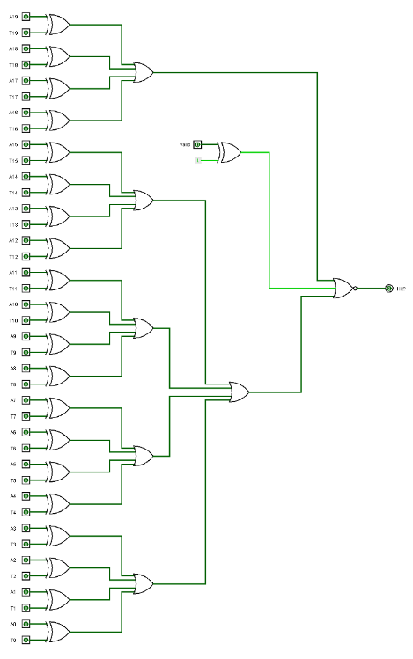
Q4

Slide 64
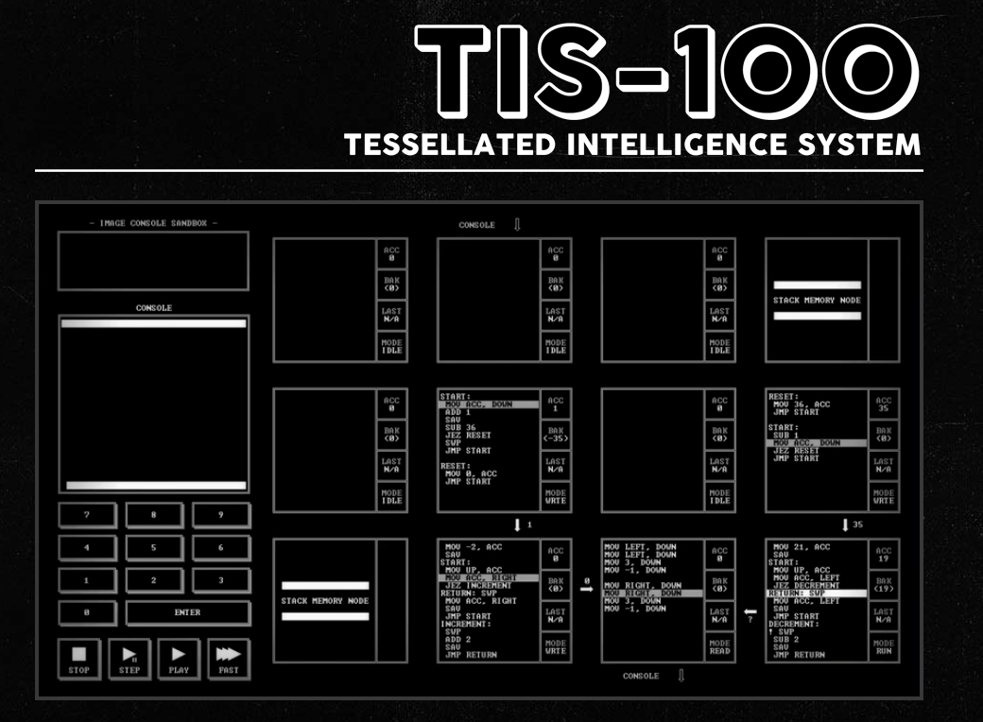
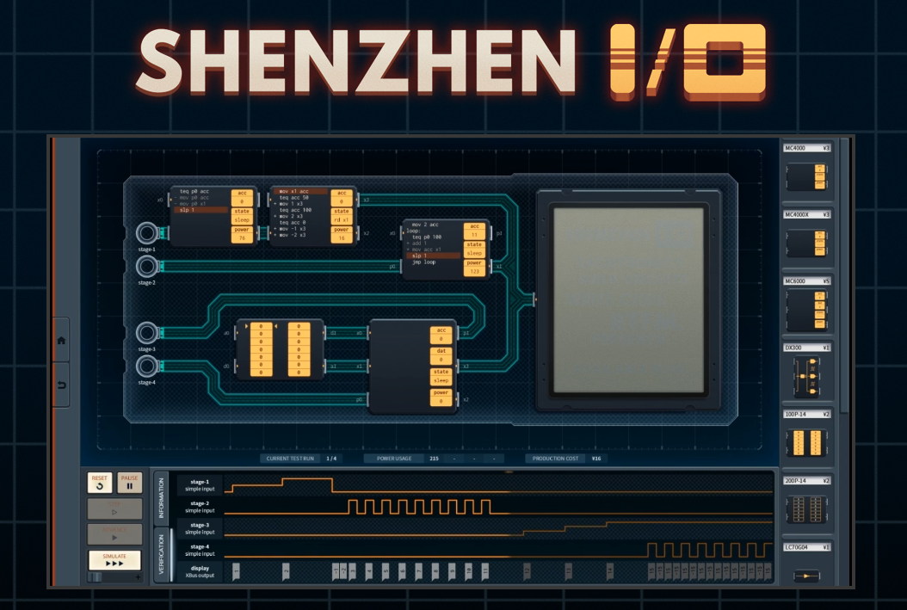

Bonus: Beyond CS2100
MIPS
Was and is used for some microprocessors
Current: Loongson / LoongArch is MIPS-compatible
Numerous other architectures besides MIPS! x86/x86-64, ARM/Arm-64, RISC V, …
If you’re interested in more assembly stuff:
CS4212 Compiler Design – you’ll make your own C to x86-lite compiler
CS2106 and some CEG Courses
A bunch of assembly games (check them out on Steam) (not sponsored or endorsed by me)

Slide 65
Bonus: Beyond CS2100
Logic Circuit
Not going to see this much if you’re taking CS
If interested in this – look into CG / EE-coded courses; may be able to audit
Caching
If you are going to take CS2106 (Operating Systems), you will see something really similar under the Paging topic
Idea is the same -- put data somewhere fast if you access it multiple times
More replacement policies beyond LRU

Slide 66

End of Tutorial 11
Slides uploaded on github.com/theodoreleebrant/TA-2425S1
Email: theo@comp.nus.edu.sg
Anonymous feedback:
bit.ly/feedback-theodore
(or scan on the right)
All the best for exams!
(Also reminder for me to take attendance)

